Slide 1
Hackathon Project
GROUP- 4 (QEA20QE005) genc training

Slide 2
Team Members
Vankadari Samhitha | 899612
Jahnvi Patel | 899504
Barbie Garg | 899717
Mounika Chandra Ragula | 899627
JayaPrakash Pediredla | 899175

Slide 3
Project Title : Calculate Trip Cost
Display total amount and charges per night for 3 holiday homes and cruise details: 1. For 4 people in Nairobi from 15th Dec-2019 to 20th Dec-2019 2. Sort the list with highest traveler rating on top. 3. Holiday home should have elevator/ List access. 4. Pick one cruise line & pick a respective cruise ship under Cruises; a. Retrieve all the languages offered and store in a List; Display the same b. Display passengers, crew & launched year
(Suggested Site: tripadvisor.in however you are free to choose any other legitimate site)

Slide 4
Detailed Description
Display Hotel name, total amount and charges per night for 3 holiday homes for 4 people in Nairobi for 5 days of stay from tomorrow's date
Should have sorted the list with highest traveler rating & should have elevator/ Lift access.
Pick one cruise line & pick a respective cruise ship under Cruises; a. Retrieve all the languages offered and store in a List; Display the same b. Display passengers, crew & launched year (Suggested Site: tripadvisor.in however you are free to choose any other legitimate site)

Slide 5
Website used:
https://www.tripadvisor.in/
Tools/Software's Used:
Selenium – Portable Framework for testing Web Applications and automating the process.
Java – High level Programming Language.
Eclipse – Integrated Development Environment for various ‘Languages’.
TestNG – Open source testing framework.
Maven – Software and project Management Tool.
POM – Object repository design pattern.
Jenkins – An open source automation server for continuous integration.
Selenium Grid – Tool use to distribute test to run test in parallel on multiple machine or browser.
GIT – A distributed version-control system for tracking changes in any set of files for better co-ordination.

Slide 6
Work Done
The code is written in JAVA language and then is further automated using Selenium.
Page Object Model(POM) is used to reduce the code duplication for various instances.
Data obtained from website is stored in Excel Sheet using Apache POI; also, data input is taken from a file with variables written in it.
Jenkins, Grid and GIT repositories are also used, so as to make it easy to make changes to various versions of code and to modularise it; also to help with continuous integration.

Slide 7
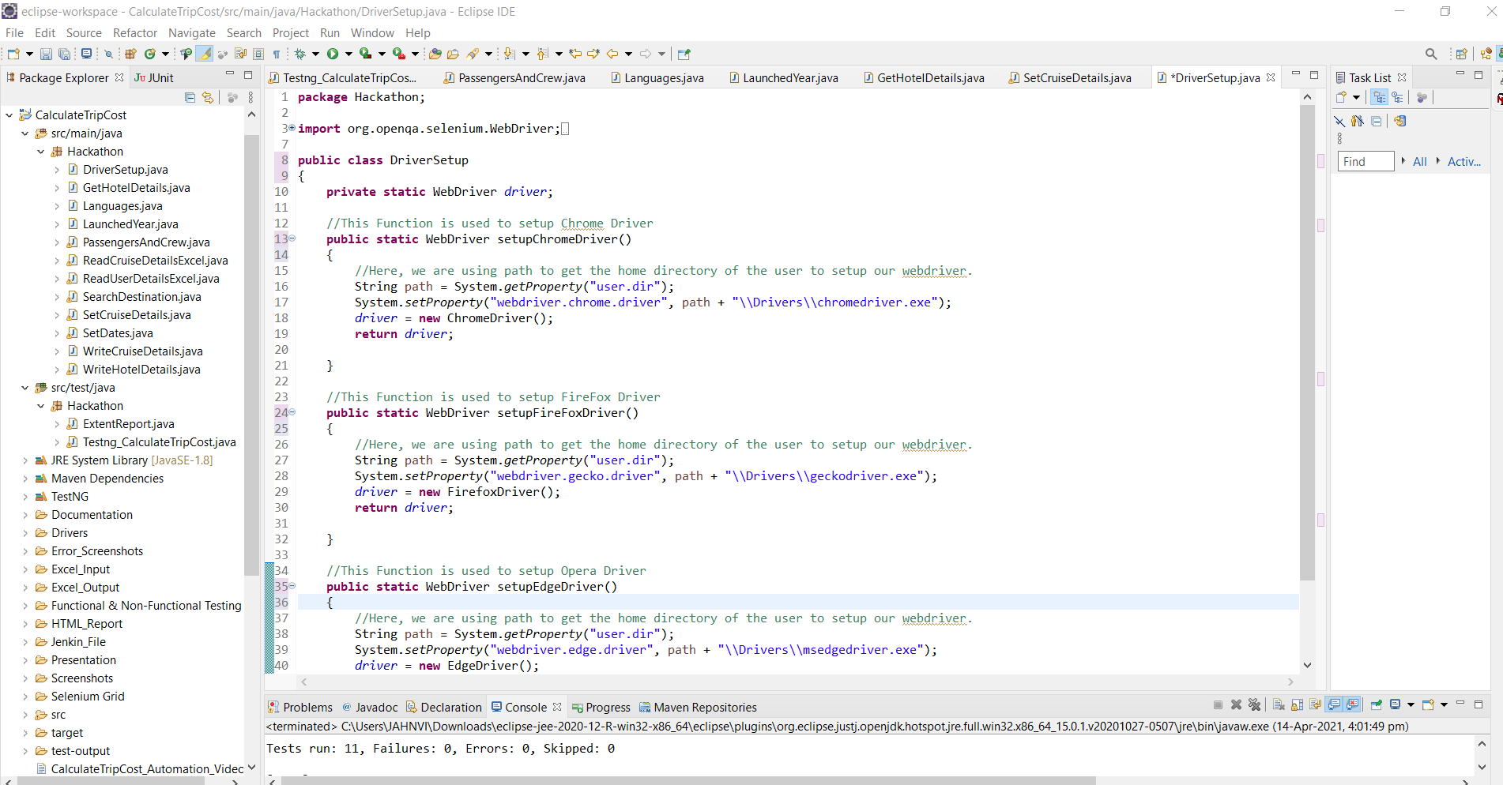
Project Structure

Slide 8
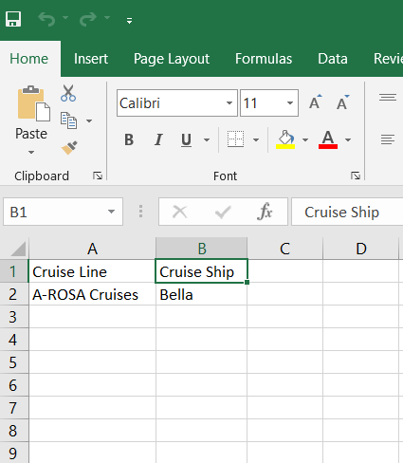
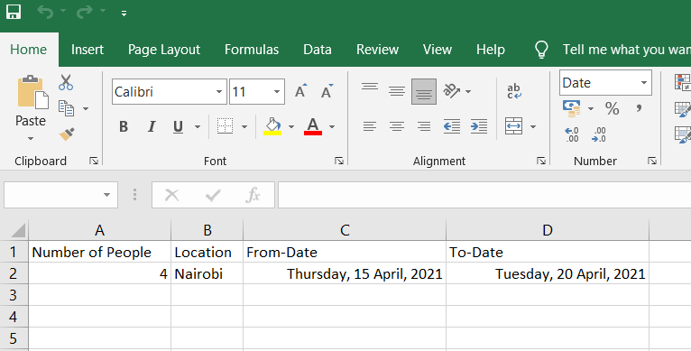
Input Excel File

Slide 9
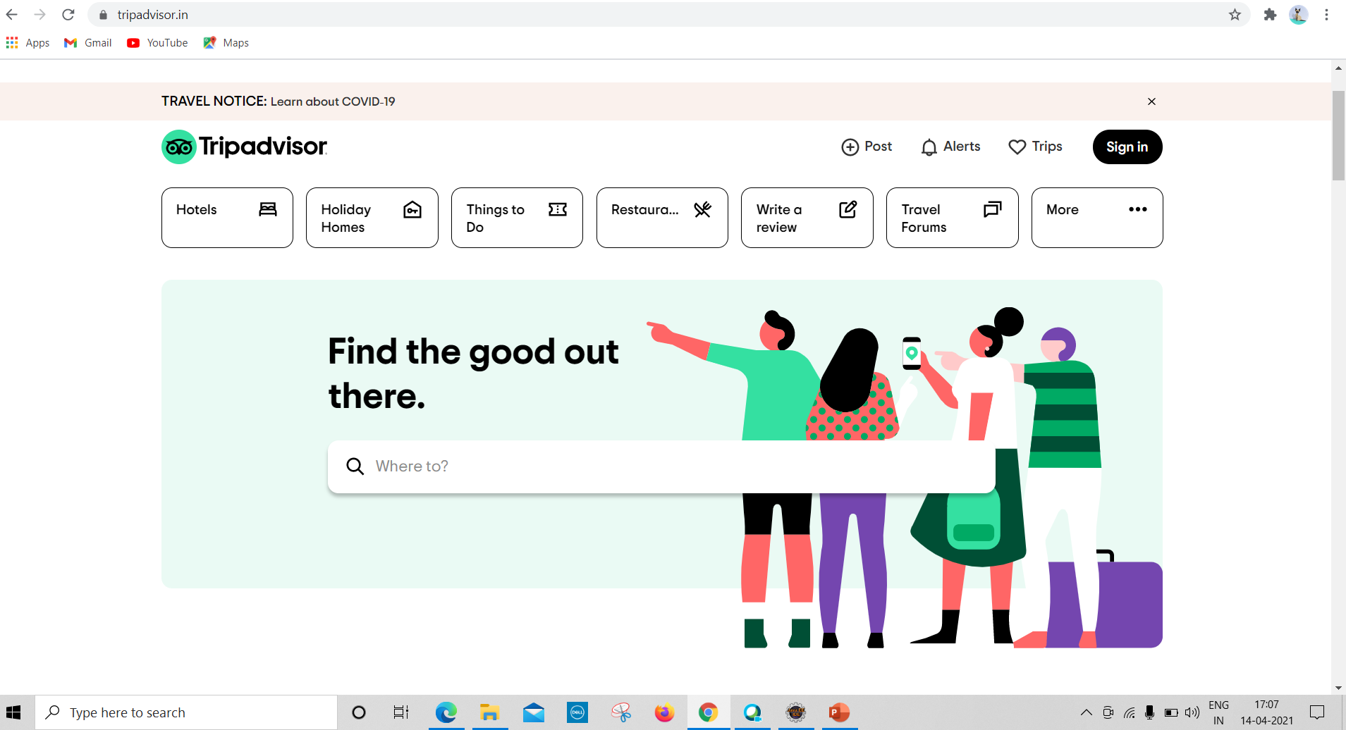
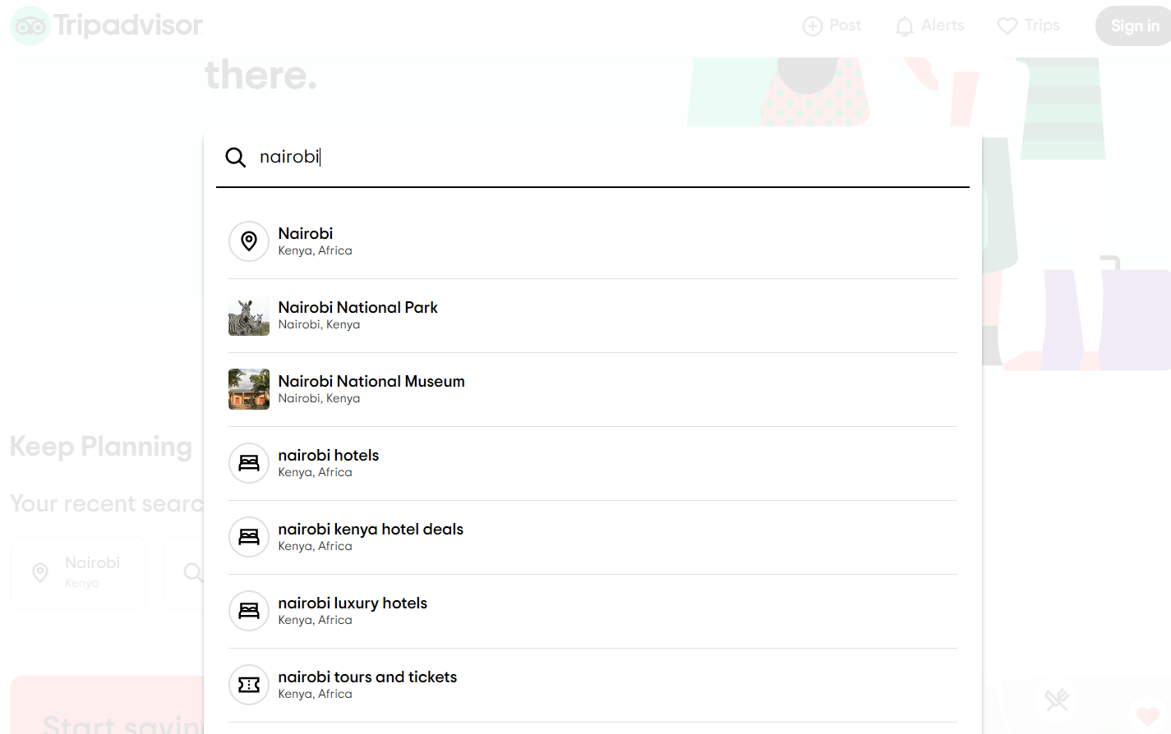
Real Time Screenshot

Slide 10
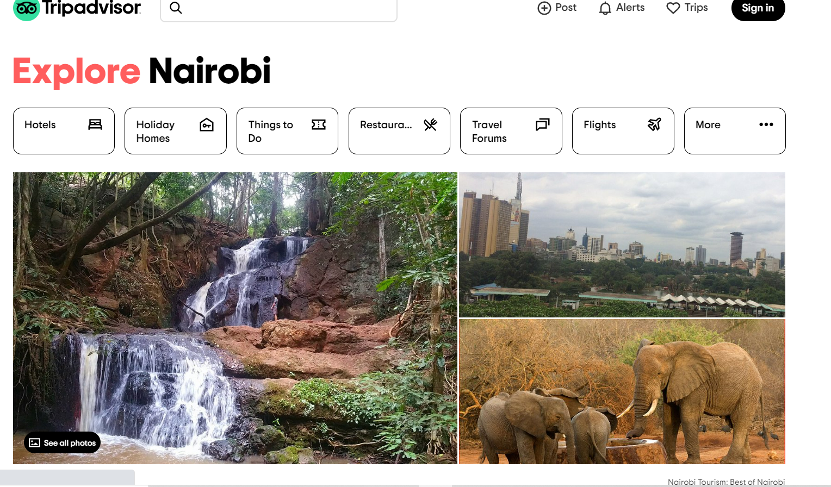
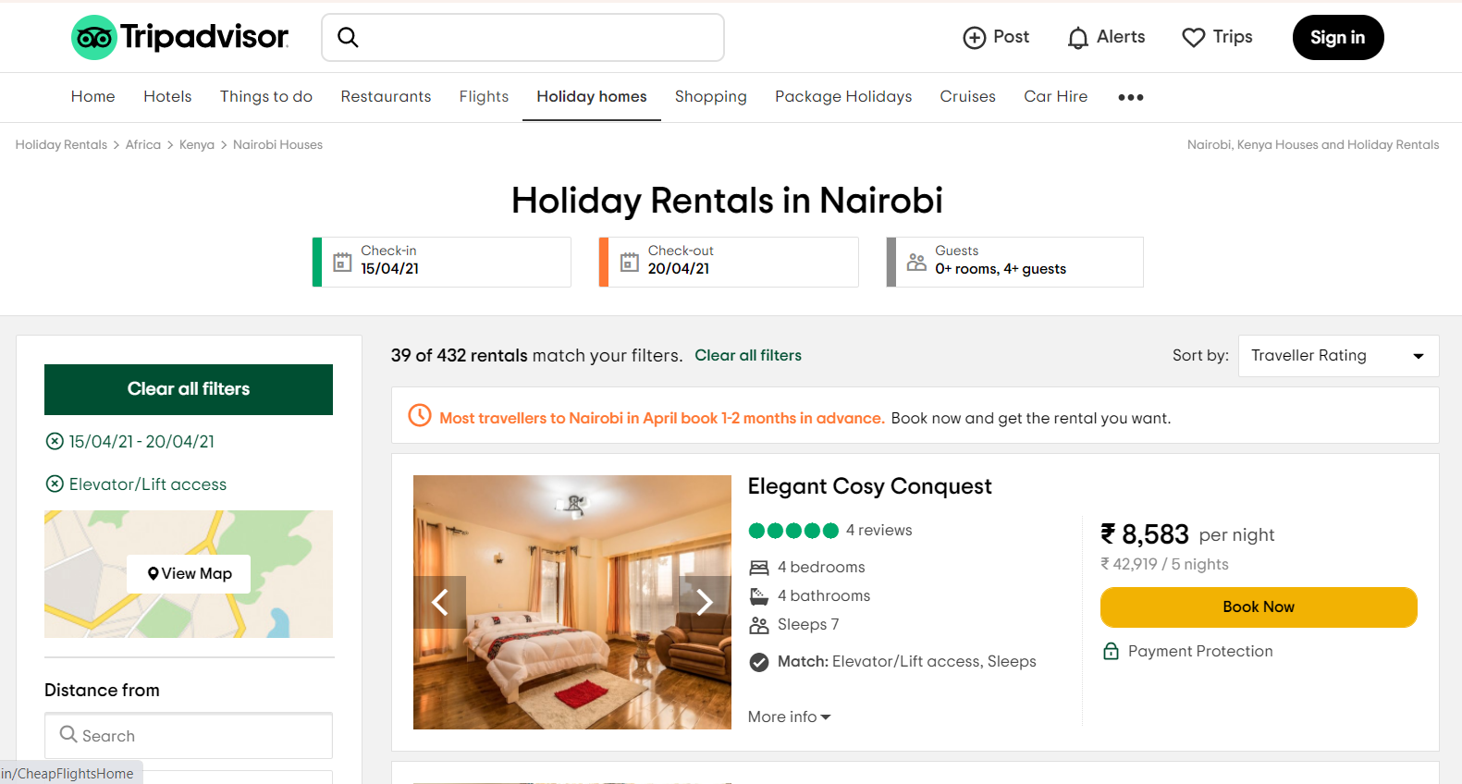
Real Time Screenshot

Slide 11
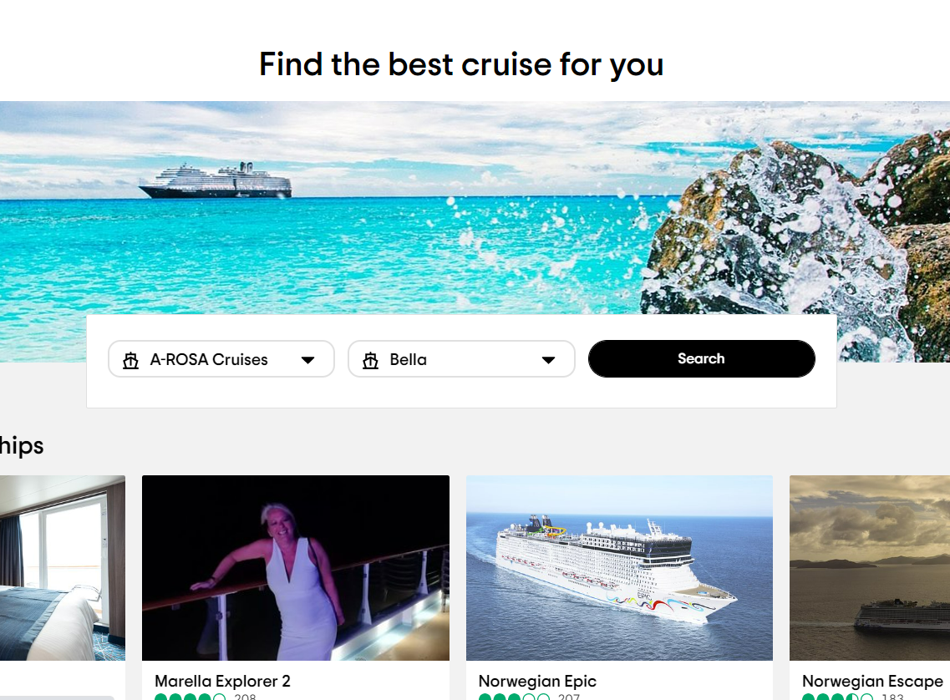
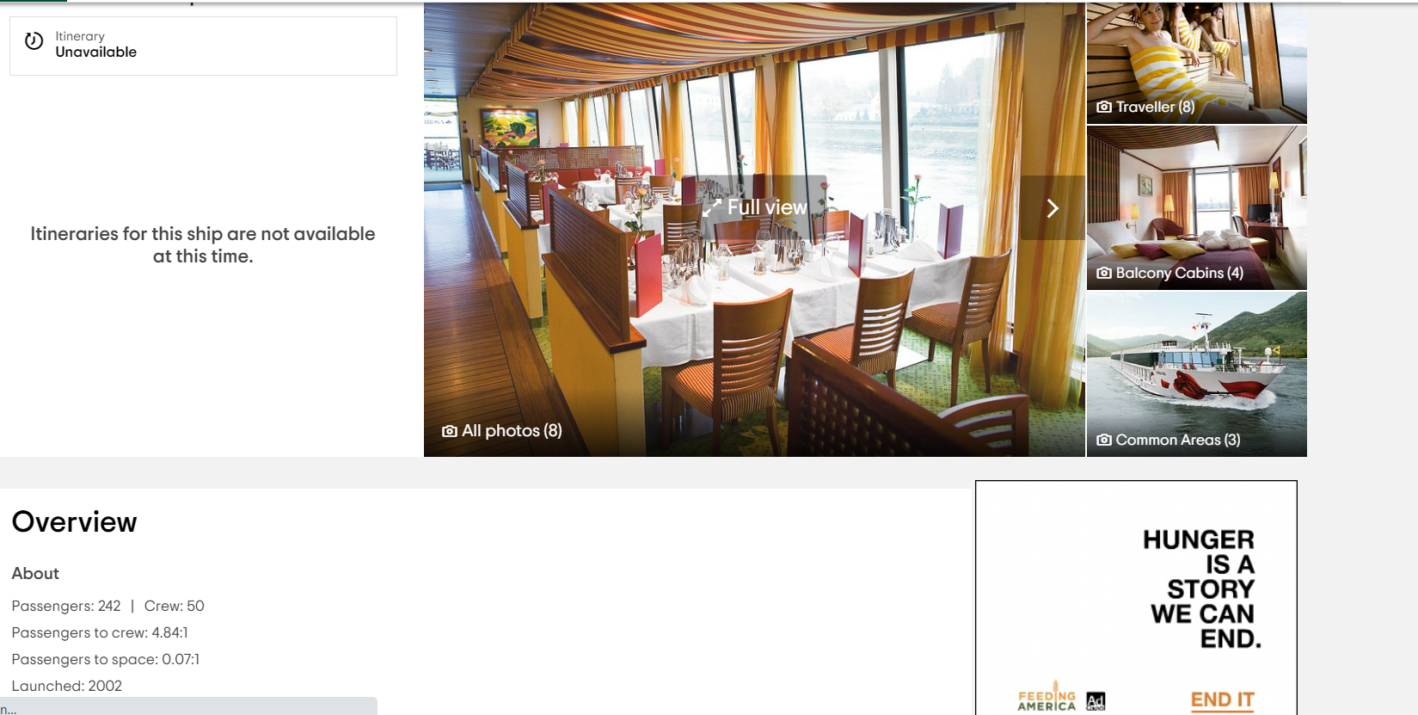
Real Time Screenshot

Slide 12
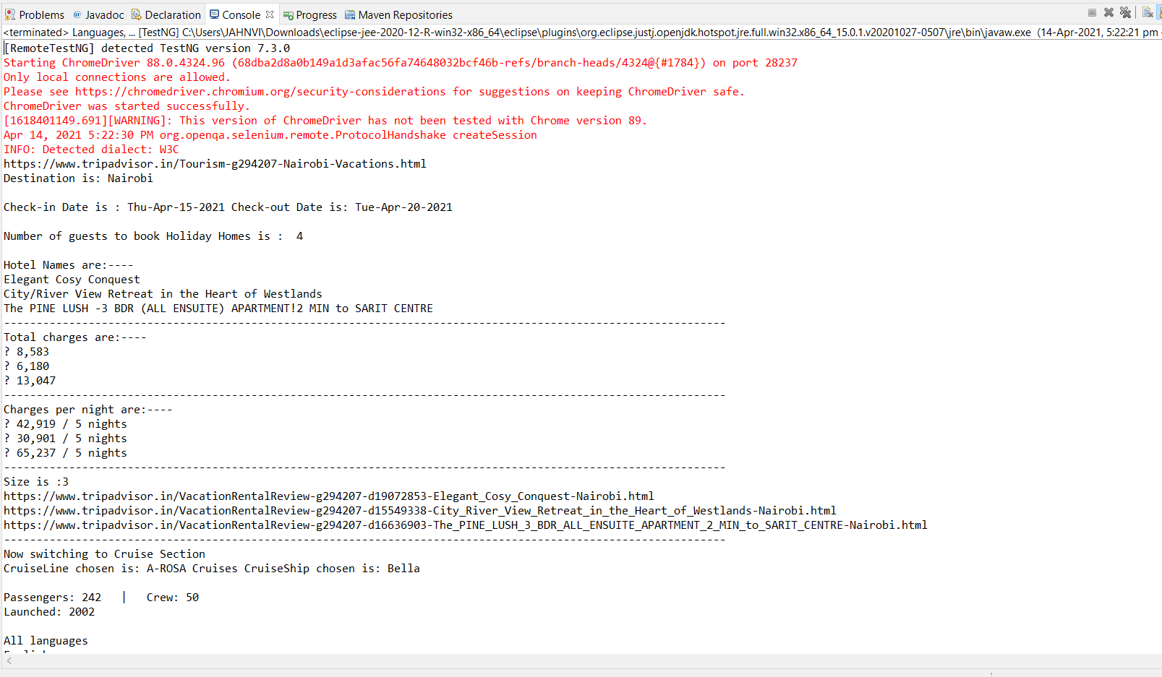
Saved Output Screenshot
TESTNG

Slide 13
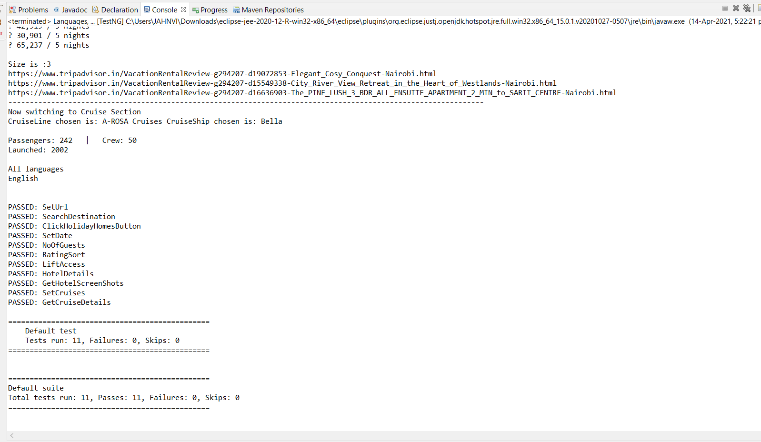
Saved Output Screenshot
MAVEN

Slide 14
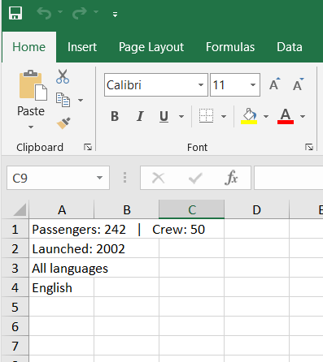
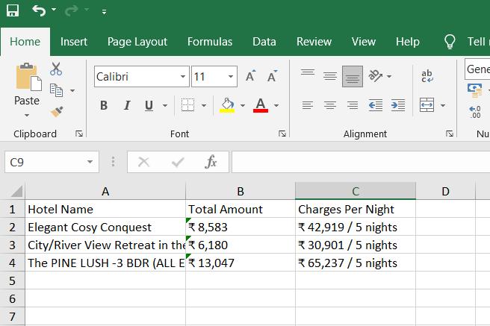
Saved Output Screenshot
EXCEL FILE

Slide 15
THANK YOU

